Slide 1

Car Price Prediction Using Machine Learning
MSDSF23M037
Talha Hussain

Slide 2
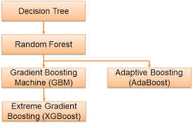
Names of Algorithums
1-Linear Regression
2-Random Forest Regressor
3-Gradient Boosting Regressor
4-XGBoost Regressor
5-Decision tree

Slide 3
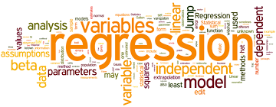
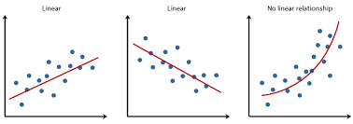
1-Linear Regression
Linear regression is a simple and interpretable regression algorithm that models the relationship between the input features and the target variable as a linear equation.
How it works: It assumes a linear relationship between the input features and the target variable and tries to find the best-fitting line through the data points.

Slide 4
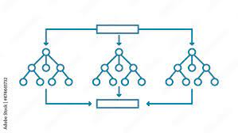
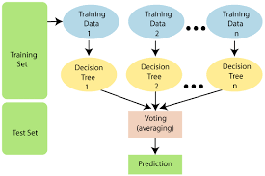
2-Random Forest Regressor
Random Forest is an ensemble learning method that constructs multiple decision trees during training and outputs the average prediction of the individual trees for regression tasks.
How it works: It builds a collection of decision trees and combines their predictions to improve overall accuracy and generalization.

Slide 5
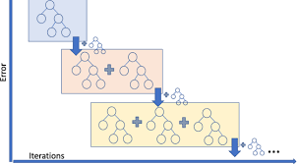
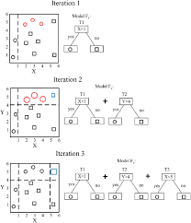
3-Gradient Boosting Regressor
Gradient Boosting is another ensemble learning technique that builds a series of weak learners (usually decision trees) sequentially, with each tree trying to correct the errors of the previous one.
How it works: It iteratively fits new trees to the residuals (errors) of the existing model, gradually improving the overall model's performance.

Slide 6
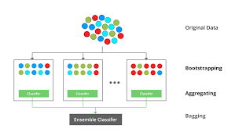

4-XGBoost Regressor
XGBoost (Extreme Gradient Boosting) is a scalable and efficient implementation of gradient boosting. It is known for its speed and performance.
How it works: Similar to traditional gradient boosting, XGBoost builds a series of decision trees sequentially, optimizing a regularized objective function to improve both accuracy and prevent overfitting.

Slide 7

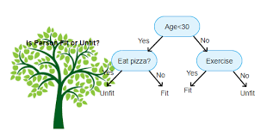
5-Decision tree
A decision tree model is a predictive algorithm that uses a tree-like structure to make decisions based on input features.
How it works:It recursively splits data into subsets, making binary decisions at each node, and assigns outcomes or predictions at the tree's leaves. The model is interpretable and widely used for classification and regression tasks in machine learning.

Slide 8
Steps
Display The Dataset
Shape of Our Dataset
Get Information About Our Dataset .
Check Null Values In The Dataset
Get Overall Statistics About The Dataset
Data Preprocessing
Outlier Removal
Encoding the Categorical Columns
Store Feature Matrix In X and Response(Target) In Vector Y
Splitting The Dataset
Import The models
Training the dataset
Tunning hyper parameters
Prediction on Test Data
Evaluating the Algorithm
Error analysis

Slide 9
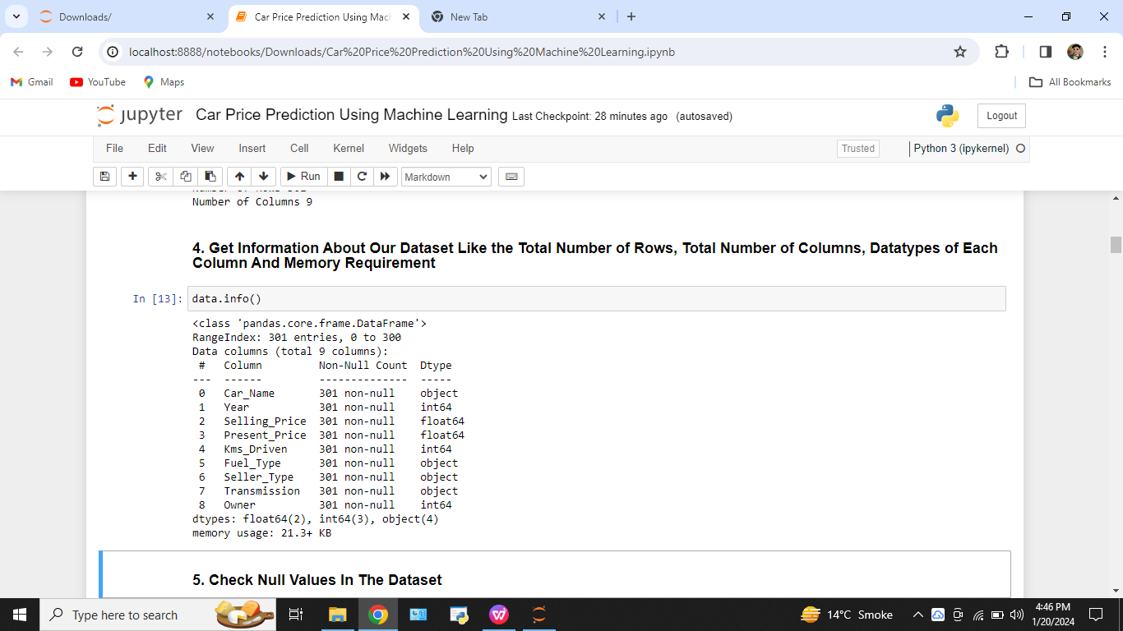
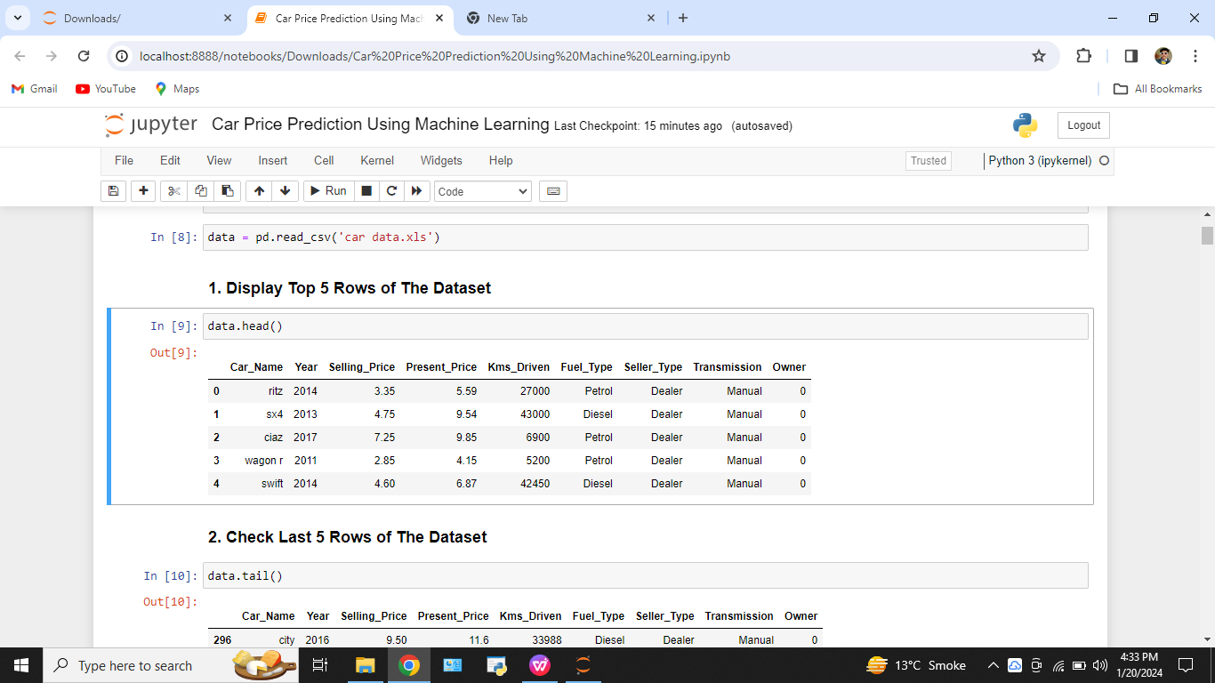
Dataset
Get Information About Our Dataset
Display the dataset
Shape of Our Dataset

Slide 10
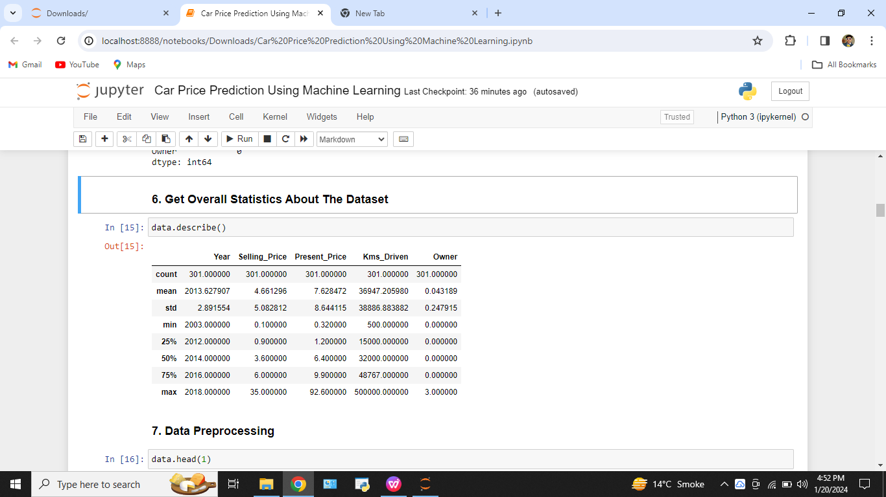
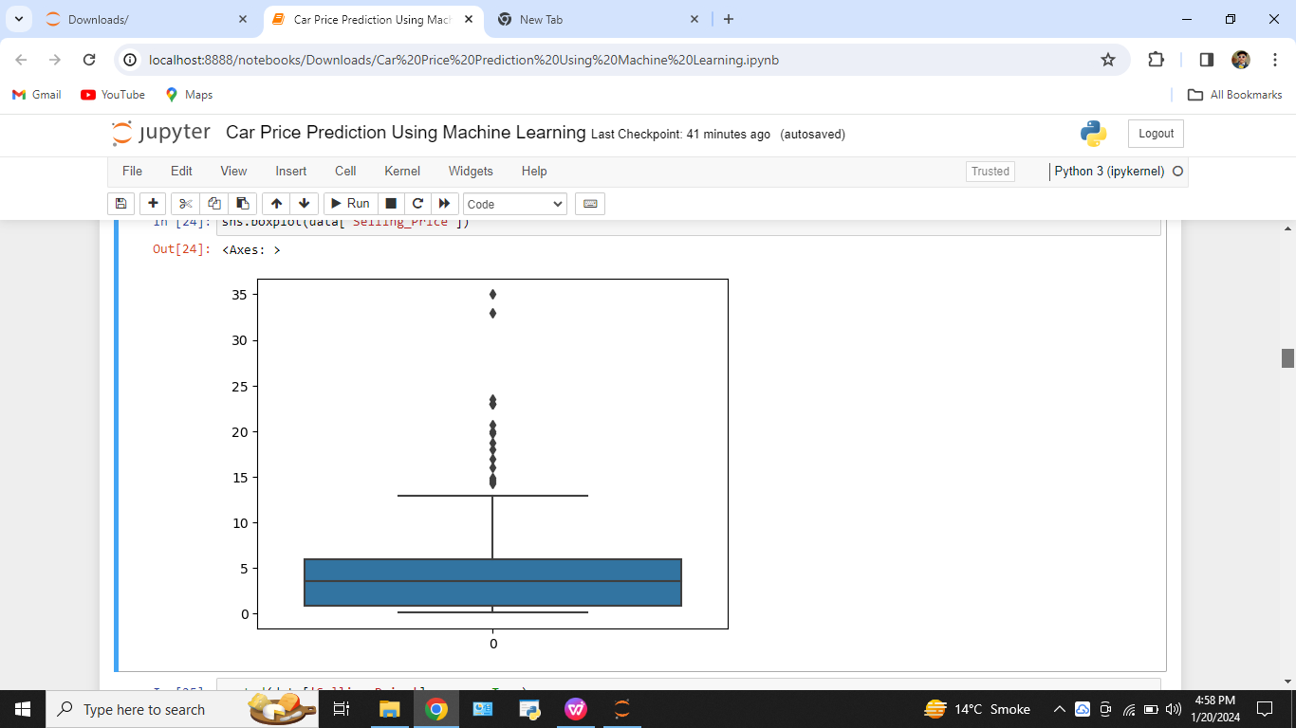
Dataset
Check Null Values In The Dataset
Get Overall Statistics About The Dataset
Data Preprocessing
Outlier Removal
Encoding the Categorical Columns
Store Feature Matrix In X and Response(Target) In Vector Y

Slide 11
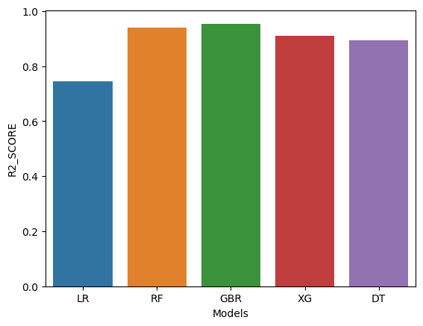
Dataset
Splitting The Dataset
Import The models
Training the dataset
Tunning hyper parameters
Prediction on Test Data
Evaluating the Algorithm

Slide 12
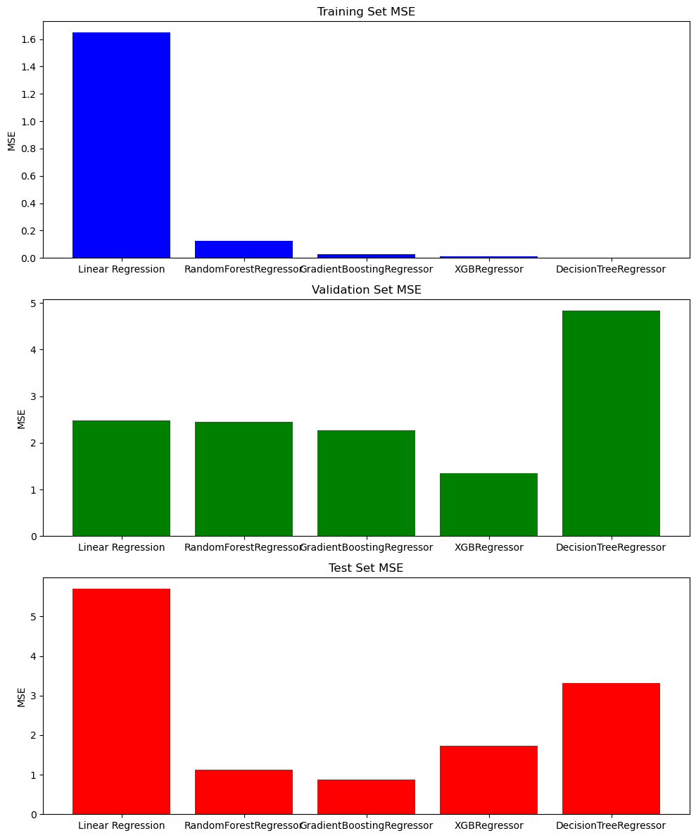
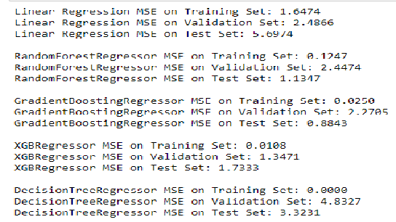
Results

Slide 13
Error analysis
Linear Regression:High training set MSE compared to validation and test sets suggests potential overfitting or complexity insufficient to capture the underlying patterns.
RandomForestRegressor:Low training set MSE, but higher validation and test set MSE indicate some overfitting. However, it's not as severe as in linear regression.
GradientBoostingRegressor:Low training, validation, and test set MSE indicate good generalization. This model seems well-tuned and balanced.
XGBRegressor:Similar to GradientBoostingRegressor, XGBRegressor shows low MSE across all sets, indicating good generalization.
DecisionTreeRegressor:MSE of 0 on the training set suggests overfitting. The high MSE on the validation and test sets indicates poor generalization.

Slide 14
Recommendations:
The RandomForestRegressor, GradientBoostingRegressor, and XGBRegressor seem to perform well without significant signs of overfitting or underfitting.
For the DecisionTreeRegressor, reducing its complexity or using techniques like pruning may help mitigate overfitting.
Fine-tuning hyperparameters or using more advanced models could improve the performance of Linear Regression.
It's essential to strike a balance between model complexity and generalization for optimal performance on unseen data. Cross-validation and hyperparameter tuning are common techniques to address overfitting and underfitting.

Slide 15
Thanks

